Slide 1
CSE 316
Project Proposal
SENTINEL
Smart Home Assistant
Section : A2
1805031 - Nahian Shabab
1805035 - Saleh Sakib Ahmed
1805044 - Md. Misbahul Hasan Jinan

Slide 2
Motivation:
We Want to Build A System to:
Remotely Control and Automate Basic Household Electrical Appliances
Monitor Environmental Parameters of Home and Take Appropriate Actions
Alert Owner about Environmental and Security Threats

Slide 3
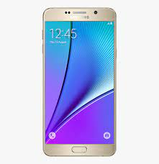
Block Diagram
Smartphone
Medium:
Bluetooth
MCU
(Arduino Based MC)
ELECTRONIC APPLIANCES
SENSORS
ACTUATORS

Slide 4






Monitoring Features
Humidity
Rain
(Auto Window Closed)
Luminosity
(Auto Light On If Too Dark)
Smoke
(Sound Alarm)
Temperature
Water Level
(Auto Refill If Low)

Slide 5
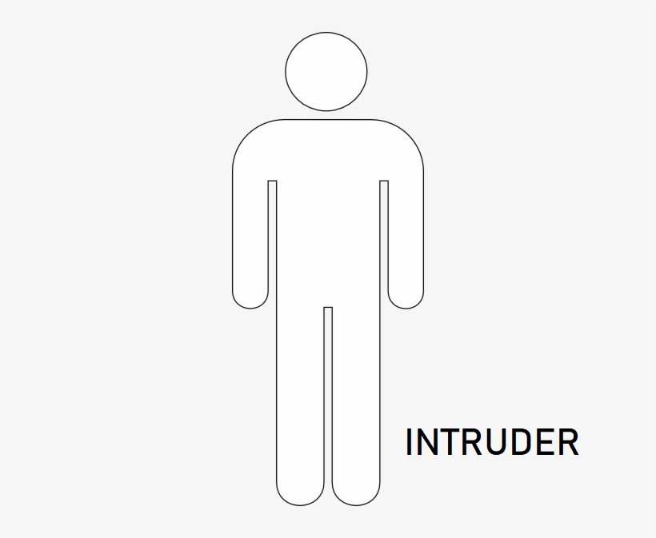


Security Feature : Intruder Detection
?#$!@?
Applicable if owner wants
!
MCU
MOTION SENSOR
there’s a guy
Buzzer
Notification to phone

Slide 6
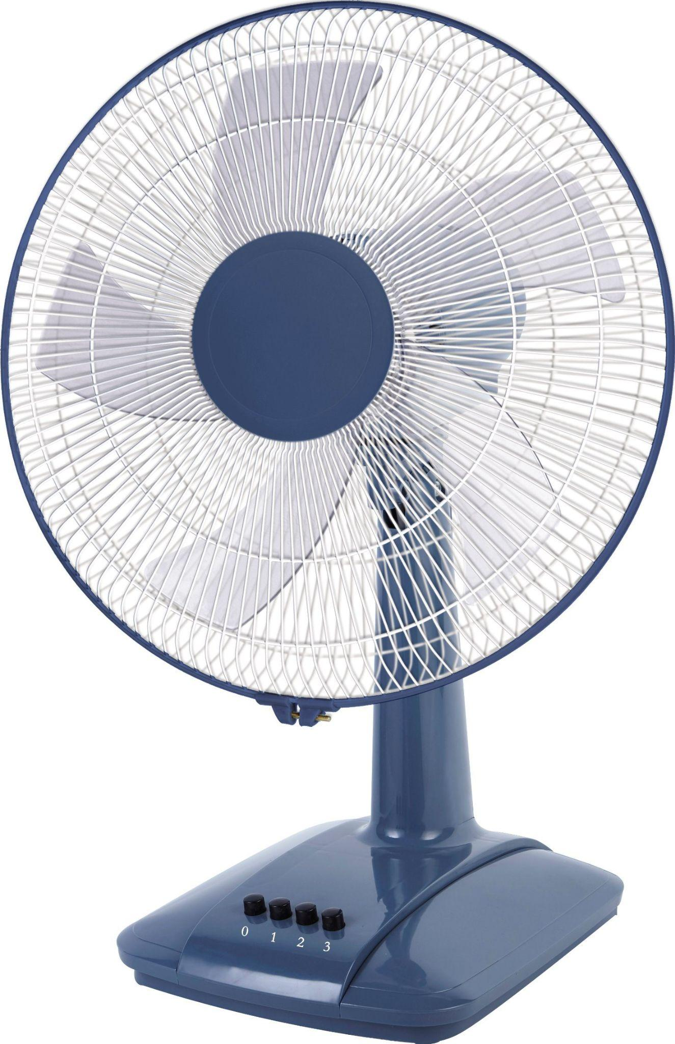



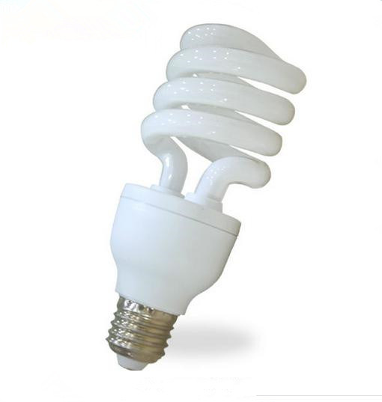


Control Features
MCU

Slide 7
Sensors
LDR (Light Dependent Resistor)
DHT22 Temperature and Humidity Sensor
MQ Series Gas Sensor
PIR Motion Sensor
Rain Sensor

Slide 8
Actuators
Servo Motor
We did a small sample project to test if it is feasible: Link

Slide 9
Thank You

